Slide 1
SCIENTIFIC COMPUTING Numerical computation & Scientific Simulation
SEBASTIÁN ROLDÁN VASCO, MSc., PhD.
sebastianroldan@itm.edu.co

Slide 2

NumPy
NumPy is an open source project that enables numerical computing with Python.
NumPy is developed in the open on GitHub, through the consensus of the NumPy and wider scientific Python community.
Developers recommend the use of the Anaconda Distribution, but it isn’t mandatory
NumPy is the main scientific computation library for Python.

Slide 3
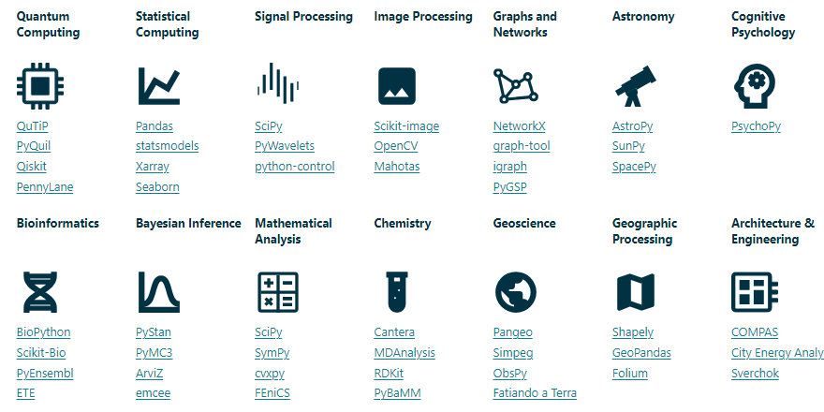
Scientific domain

Slide 4
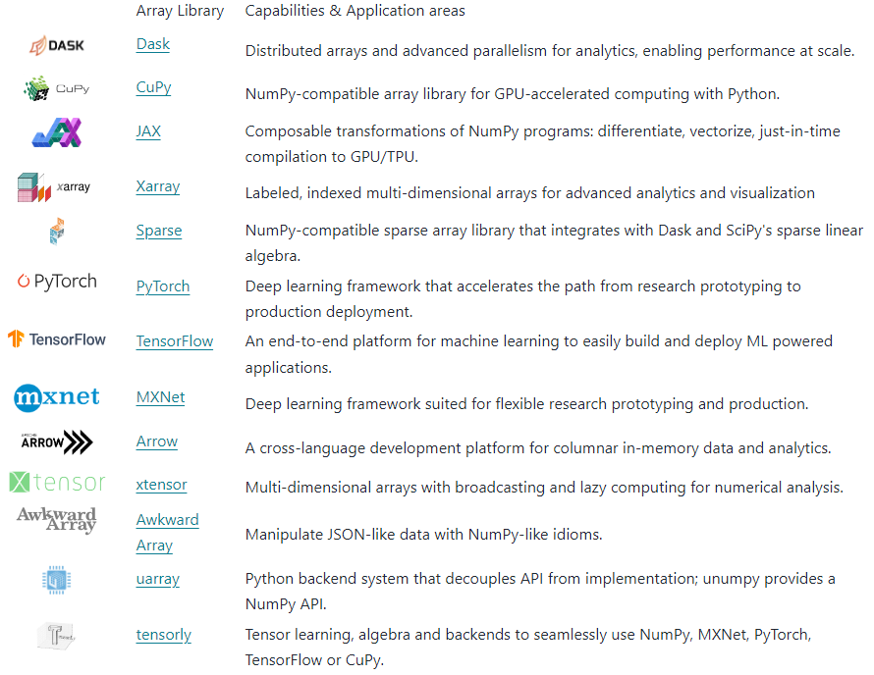
Ecosystem

Slide 5
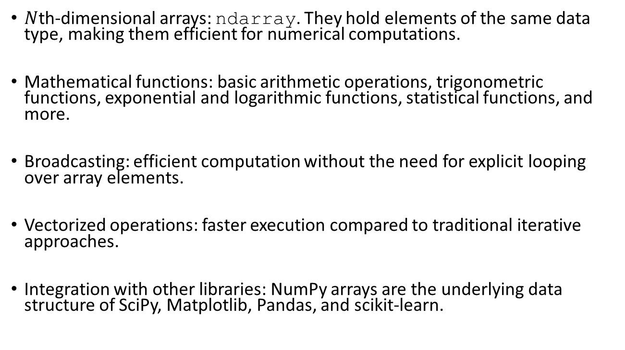
Key features
$N$th-dimensional arrays: ndarray. They hold elements of the same data type, making them efficient for numerical computations.
Mathematical functions: basic arithmetic operations, trigonometric functions, exponential and logarithmic functions, statistical functions, and more.
Broadcasting: efficient computation without the need for explicit looping over array elements.
Vectorized operations: faster execution compared to traditional iterative approaches.
Integration with other libraries: NumPy arrays are the underlying data structure of SciPy, Matplotlib, Pandas, and scikit-learn.

Slide 6
NumPy arrays
What is an array?
It is a grid of elements that can be indexed in different ways.
All elements are of the same data type (dtype).
Supported data types:
Signed and unsigned integers: int8, uint8, int16, uint16, int32, uint32, int64, uint64
Floating-point numbers: float16, float32, float64, float128
Booleans
Complex numbers: complex64, complex128, complex256
Objects: object

Slide 7
Arrays vs. lists
NumPy has a large number of numerical manipulation methods.
Lists can contain various data types, whereas NumPy data must be homogeneous.
NumPy arrays are faster and more compact than Python lists.
NumPy arrays occupy much less memory than Python lists.

Slide 8
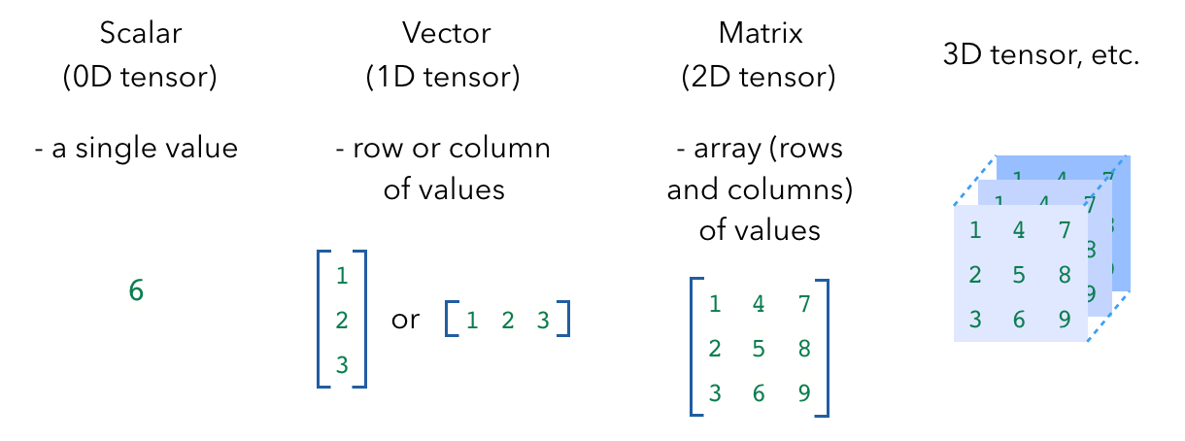
Numpy arrays
https://madewithml.com/courses/foundations/numpy/

Slide 9

SciPy
SciPy extends NumPy providing additional tools for:
Array computing
Specialized data structures, e.g. sparse matrices and k-dimensional trees.
SciPy is open-source. It is developed and maintained publicly on GitHub
SciPy wraps highly-optimized implementations written in low-level languages like Fortran, C, and C++, but with a high-level syntax
Algorithms for optimization, integration, interpolation, eigenvalue problems, algebraic equations, differential equations, etc.

Slide 10
SciPy
SciPy extends NumPy providing additional tools for:
Array computing
Specialized data structures, e.g. sparse matrices and k-dimensional trees.
SciPy is open-source. It is developed and maintained publicly on GitHub
SciPy wraps highly-optimized implementations written in low-level languages like Fortran, C, and C++, but with a high-level syntax
Algorithms for optimization, integration, interpolation, eigenvalue problems, algebraic equations, differential equations, etc.

Slide 11
SciPy
NumPy | SciPy
Focused on numerical computing with arrays | SciPy is built on top of NumPy
It provides support for multi-dimensional arrays and matrices | It includes modules for optimization, integration, interpolation, linear algebra, statistics, signal processing, and more
Efficient array operations | Higher-level functionality
Core functionality: basic mathematical functions, array creation routines, indexing, slicing, and reshaping operations | Integration with other libraries
Basic linear algebra: matrix multiplication, determinant calculation, and solving linear equations | Advanced algorithms: numerical integration, optimization algorithms, and special mathematical functions

